Slide 1

HOTEL MANAGEMENT SYSTEM
TEAM MEMBERS
S R Gurumeeta - 927621bad012
I Haripriya - 927621bad013
R Jothika - 927621bad019
N Pranishka - 927621bad037
GUIDED BY
Mr.Stalinbabu
AP / AI

Slide 2
AGENDA
Introduction
Objectives
Existing system
Problem Statement
Proposed system
Modules & Implementation
Comparison (with existing)
Conclusion
Screen Shots
References

Slide 3
INTRODUCTION
This project will consist of creating an application mainly for reserving a hotel room.Modules of the software will include booking & viewing rooms for users to give them flexibility and portability.The purpose of creating the system is improving the customer service by providing convenience to customer to make booking through system and increase customers.

Slide 4
OBJECTIVE
The main objective of the entire activity is to automate the process of day to day activities of hotel like:
Room activities
Admission of a New Customer
Assign a room according to customer’s demand
Packages available
Advance online bookings
Online Cancellation

Slide 5
EXISTING SYSTEM
To find out information about locations and to make reservations , customers currently have to contact numerous agencies. This frequently takes a lot of time and work.
Customers who visit these locations might not receive the information they want and frequently end up being misinformed. To correctly develop and execute a specific journey is laborious for a customer

Slide 6
PROBLEM STATEMENT
Despite the fact that event – based strategies are widely accepted as a method for marketing and destination development and despite the numerous advantages that events can bring to destinations, event tourism strategies have received little attention in the literature and research on tourism
Consequently , there is little knowledge of how destinations evolve and take shape ,despite the growing importance of events in destination marketing campaign

Slide 7
PROPOSED SYSTEM
The suggested system operates as a web - based application and maintains a centralised store of all relevant data.
The system makes it simple to get the necessary information and book the required travel.
Users can choose the destinations to visit and make online reservations for transportation and lodging.

Slide 8
MODULES
Module 1 : Login Page
Module 2 : Hotel Page
Module 3 : Booking Page
Module 4 : Confirm Page
Module 5 : Sign Up Page
Module 6 : Reset Page

Slide 9
IMPLEMENTATION

Slide 10
COMPARISON

Slide 11
CONCLUSION
The application was developed using Javascript, HTML technology. Any users can this application. The user can log in, with his information such as his email and password. If the login does not go through, the user can re-register or ask to change the password.After login. the user can view the homepage and can select the hotel of their interests and prebook rooms, event halls,food menu according to their convenience.

Slide 12
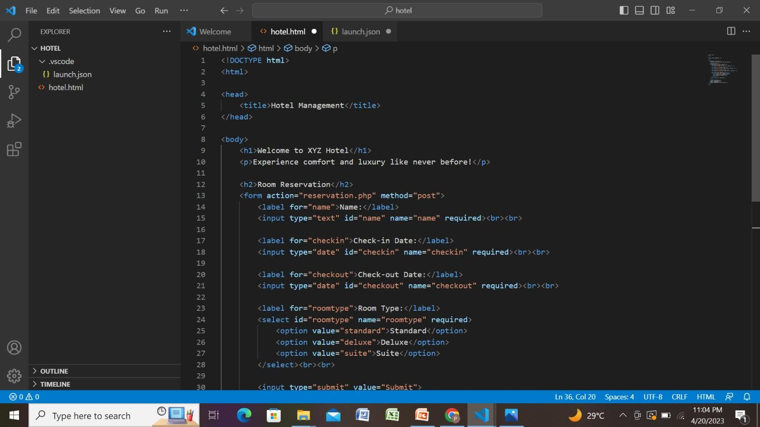
SCREENSHOTS

Slide 13
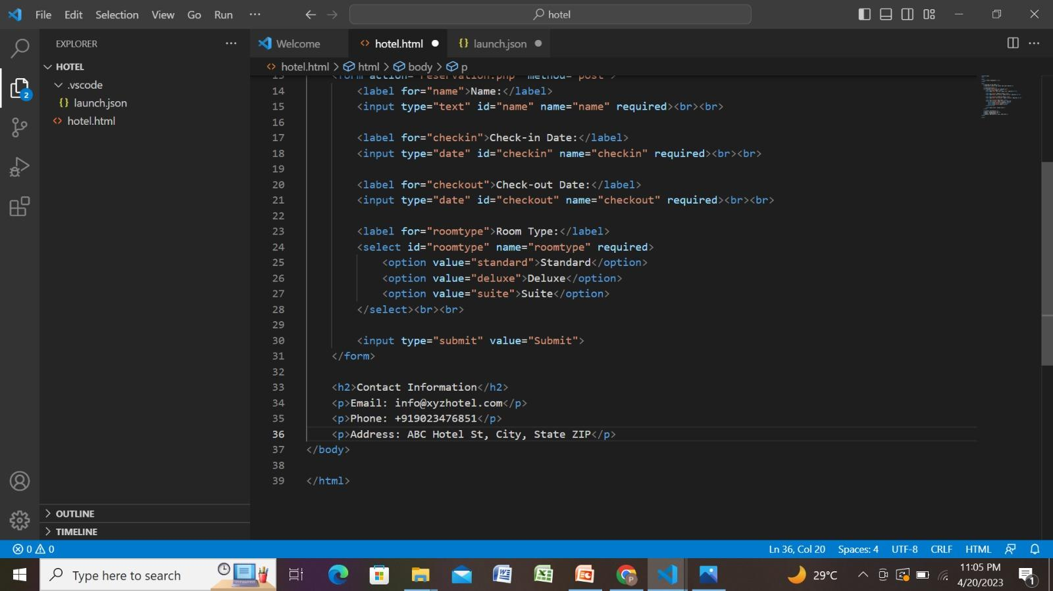

Slide 14
REFERENCES
https://www.academia.edu/2112330/A_SAMPLE_HOTEL_MANAGEMENT_SYSTEM_PROJECT_DOCUMENTATIOh
https://www.studocu.com/in/document/sanskriti-university/byech/hotel-management-project-file/28430897N

